Slide 1

Exploratory Data Analysis
G2M insight for Cab Investment firm
21/11/2023

Slide 2
Agenda
Executive Summary
Problem Statement
Approach
EDA
Hypothesis Tests
Recommendations

Slide 3
Executive
Summary
We are considering investing in the cab industry, and I have been tasked with analyzing data from two cab companies to identify the right company to make our investment.
I have been provided with four individual data sets that contain information on cab transactions, customer demographics, transaction-to-customer mapping, and city data. I will need to fully investigate and understand each data set, as well as review the source documentation and perform other analysis.
I will also need to create multiple hypotheses and investigate. For example, I could investigate whether there is any seasonality in the number of customers using the cab service. I will also need to identify which company has maximum cab users at a particular time period, whether margin proportionally increases with an increase in the number of customers, and the attributes of these customer segments.
Finally, I will prepare a presentation that summarizes my analysis and recommendations and identifies which company is performing better and is a better investment opportunity for XYZ.

Slide 4
Problem Statement
How can XYZ identify the cab company that is a better investment opportunity based on the provided data sets?
This problem statement is clear, concise, and actionable. It also identifies the key stakeholders in the problem (XYZ) and the desired outcome (identifying the better investment opportunity).
The problem statement could also be broken down into more specific questions, such as:
Which company has a higher profit margin?
Which company has a more loyal customer base?
Which company is better positioned for future growth?

Slide 5
Approach
I looked at the data from the two cab companies to understand their performance and potential. I used statistics to test my ideas about the data and to find patterns. I didn't use any machine learning techniques, but I still found some important information that will help XYZ make a decision about which company to invest in.

Slide 6
Exploratory Data Analysis
Cab Transaction Data
The cab transaction data includes information about each cab ride, such as the transaction ID, date of travel, company, city, KM traveled, price charged, and cost of trip. This data can be used to analyze the performance of each company, such as their ridership trends, revenue, and profit.
Customer Demographic Data
The customer demographic data includes information about each customer, such as their customer ID, gender, age, and income. This data can be used to segment the customer base and identify the most profitable segments.
Transaction-to-Customer Mapping Data
The transaction-to-customer mapping data links each transaction to the corresponding customer ID. This data can be used to identify customer loyalty patterns, such as frequency of use and average spend.
City Data
The city data includes information about each city, such as its population and number of cab users. This data can be used to identify factors that may influence the performance of cab companies, such as population density and traffic congestion.

Slide 7
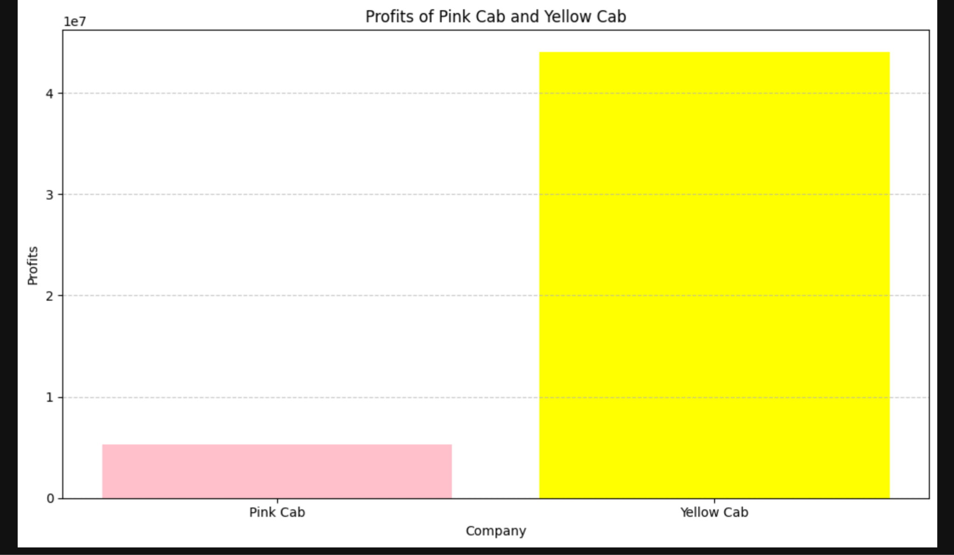
Exploratory Data Analysis
Yellow Cab outperforms Pink Cab in profitability and growth

Slide 8
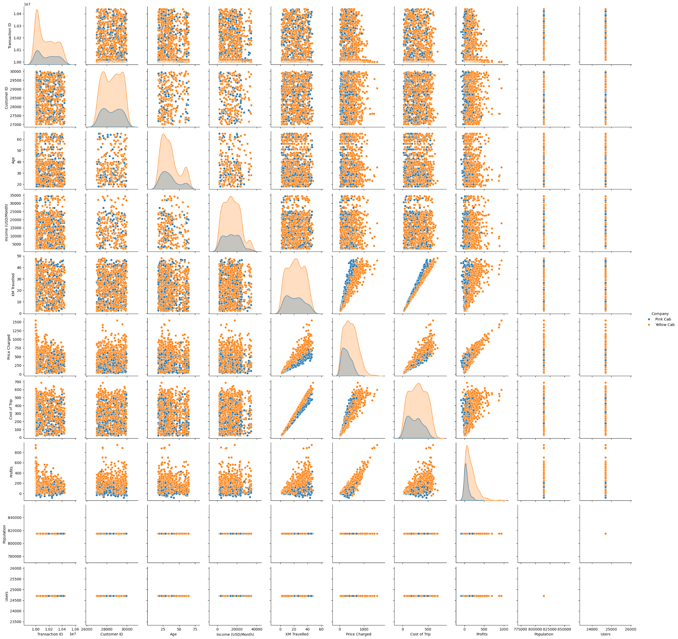
Exploratory Data Analysis
An overall comparison of both companies to understand more about them

Slide 9
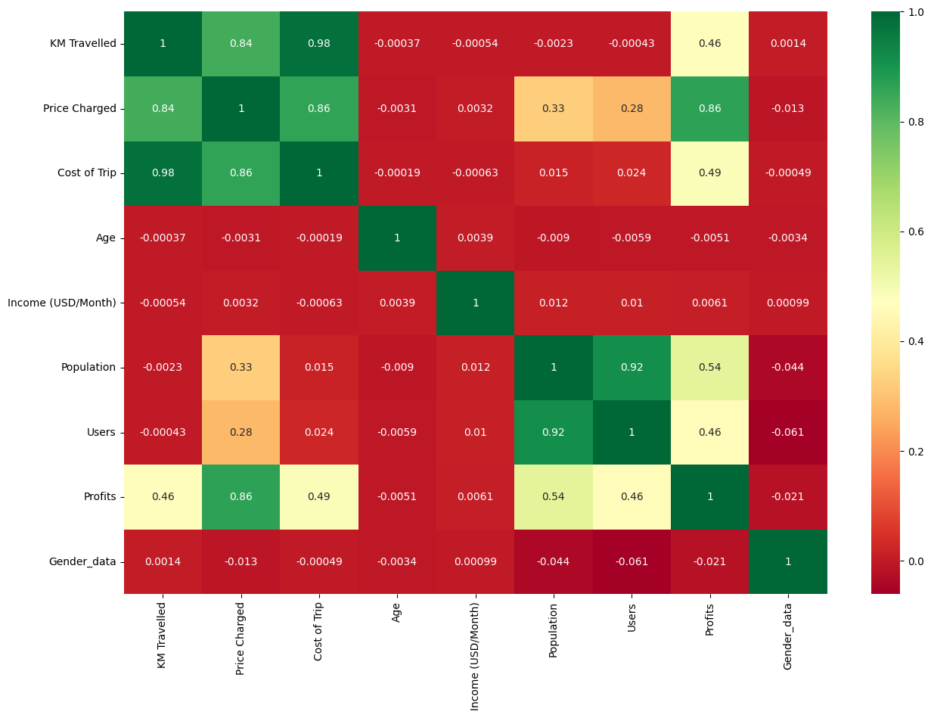
Exploratory Data Analysis
There is a huge correlation between Km Travelled and Cost of Trip There is also correlation between Km travelled and Price charged also price charged and profits along with cost of trip

Slide 10
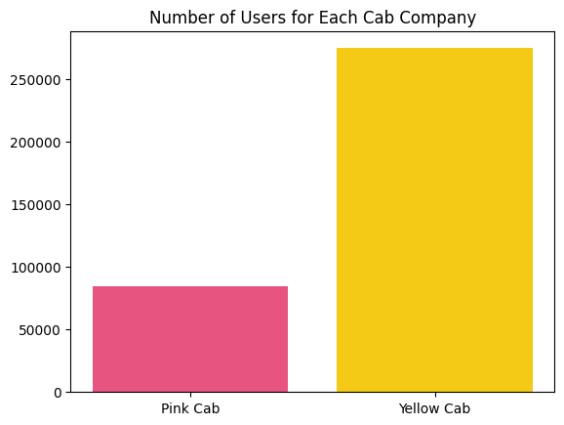
Exploratory Data Analysis
The Yellow Cab has more number of users when compared to Pink cab

Slide 11
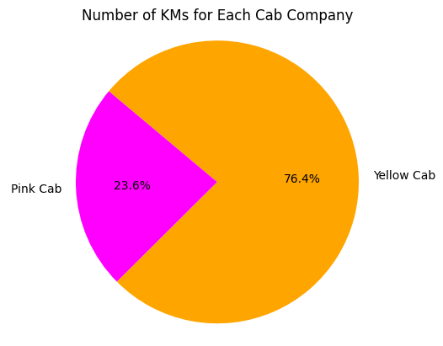
Exploratory Data Analysis
We can see that the Yellow cab company travelled more than pink cab

Slide 12
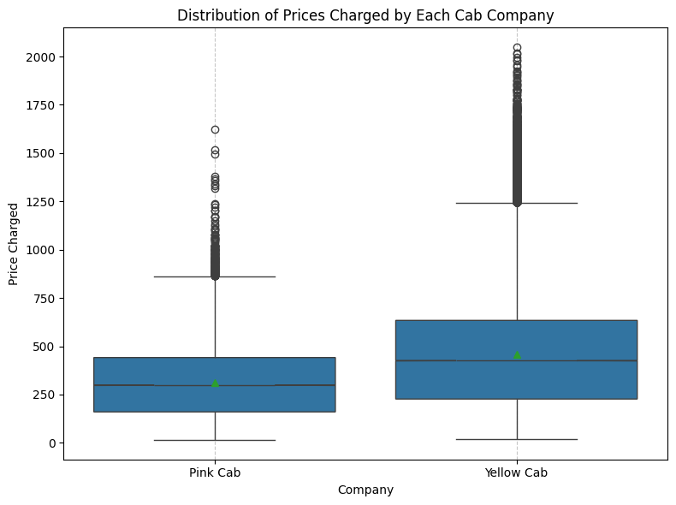
Exploratory Data Analysis
The prices charged by pink cab is less than what the yellow cab charges.

Slide 13
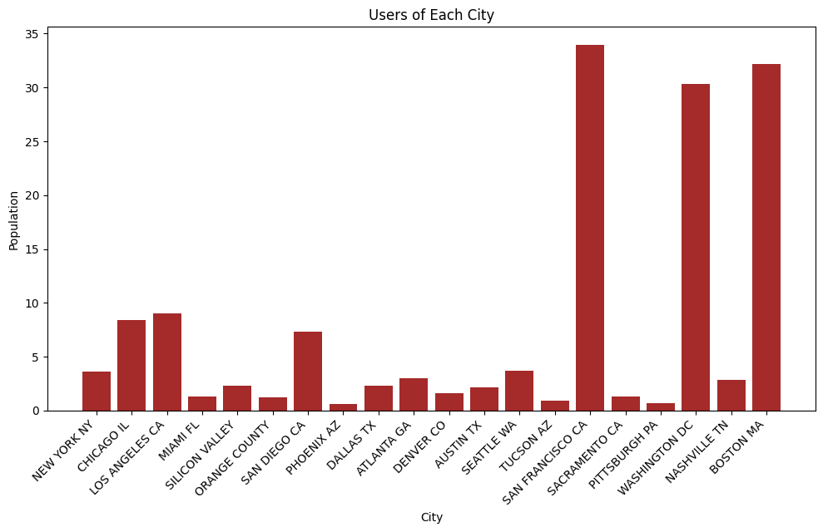
Exploratory Data Analysis
The majority of the cab users are from San Francisco, Washington and Boston

Slide 14
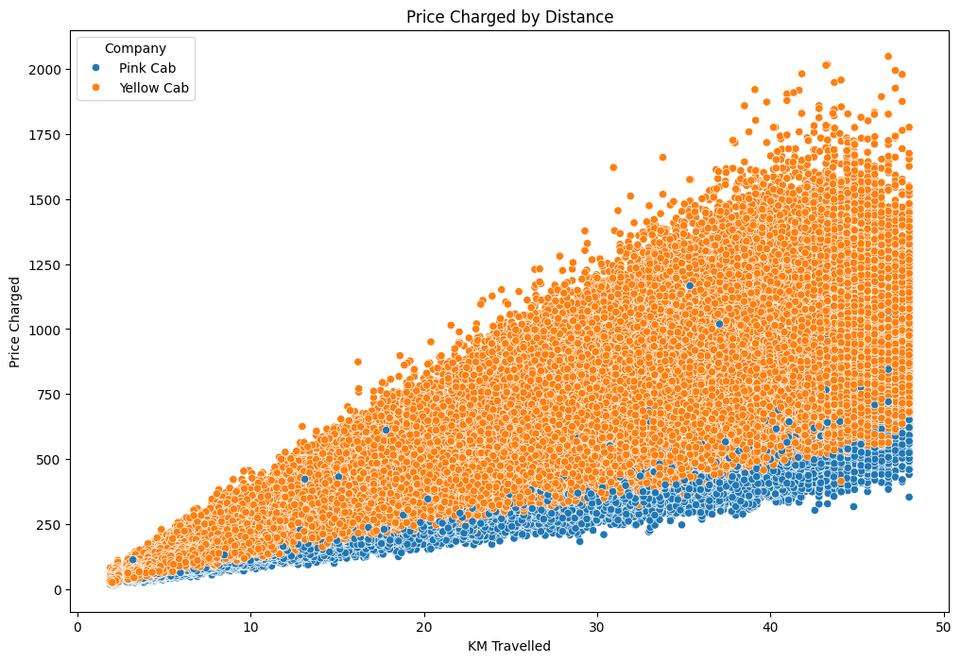
Exploratory Data Analysis
We can see that both the cabs charge the prices linearly along with distance.

Slide 15
Hypothesis
Tests
Using the data and EDA, I have come up with the following hypothesis:
Hypothesis 1: There is difference in the number of users in the cities that these cabs run
Hypothesis 2: There is difference in the gender of users for both the cabs
Hypothesis 3: There is difference in the income of users for both the cabs

Slide 16
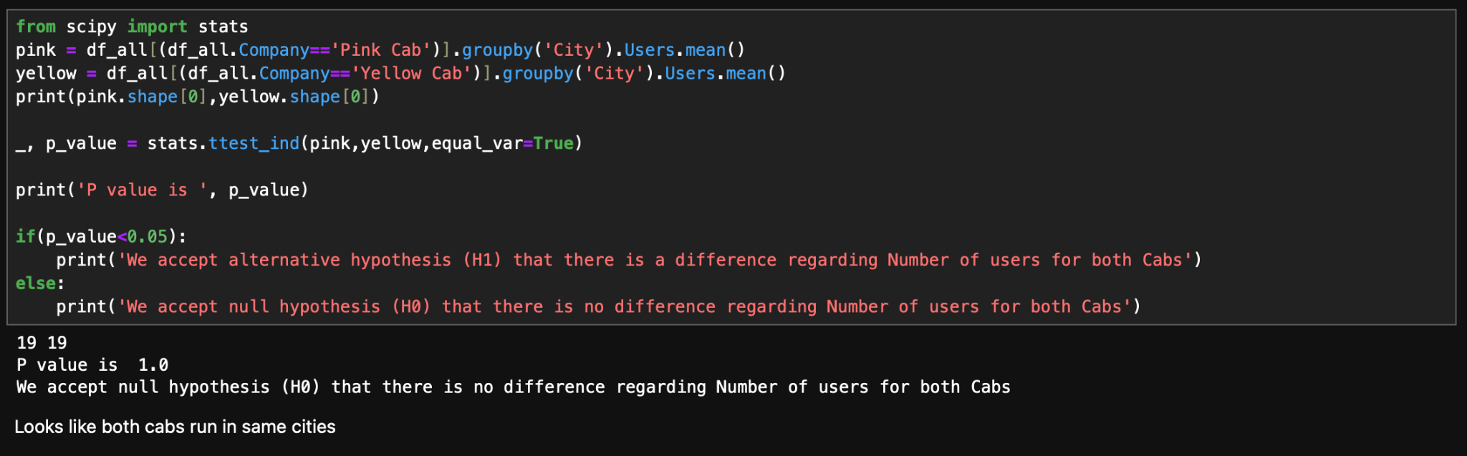
Hypothesis Testing
H₀: There is difference in the number of users in the cities that these cabs run
H₁: There is no such difference

Slide 17
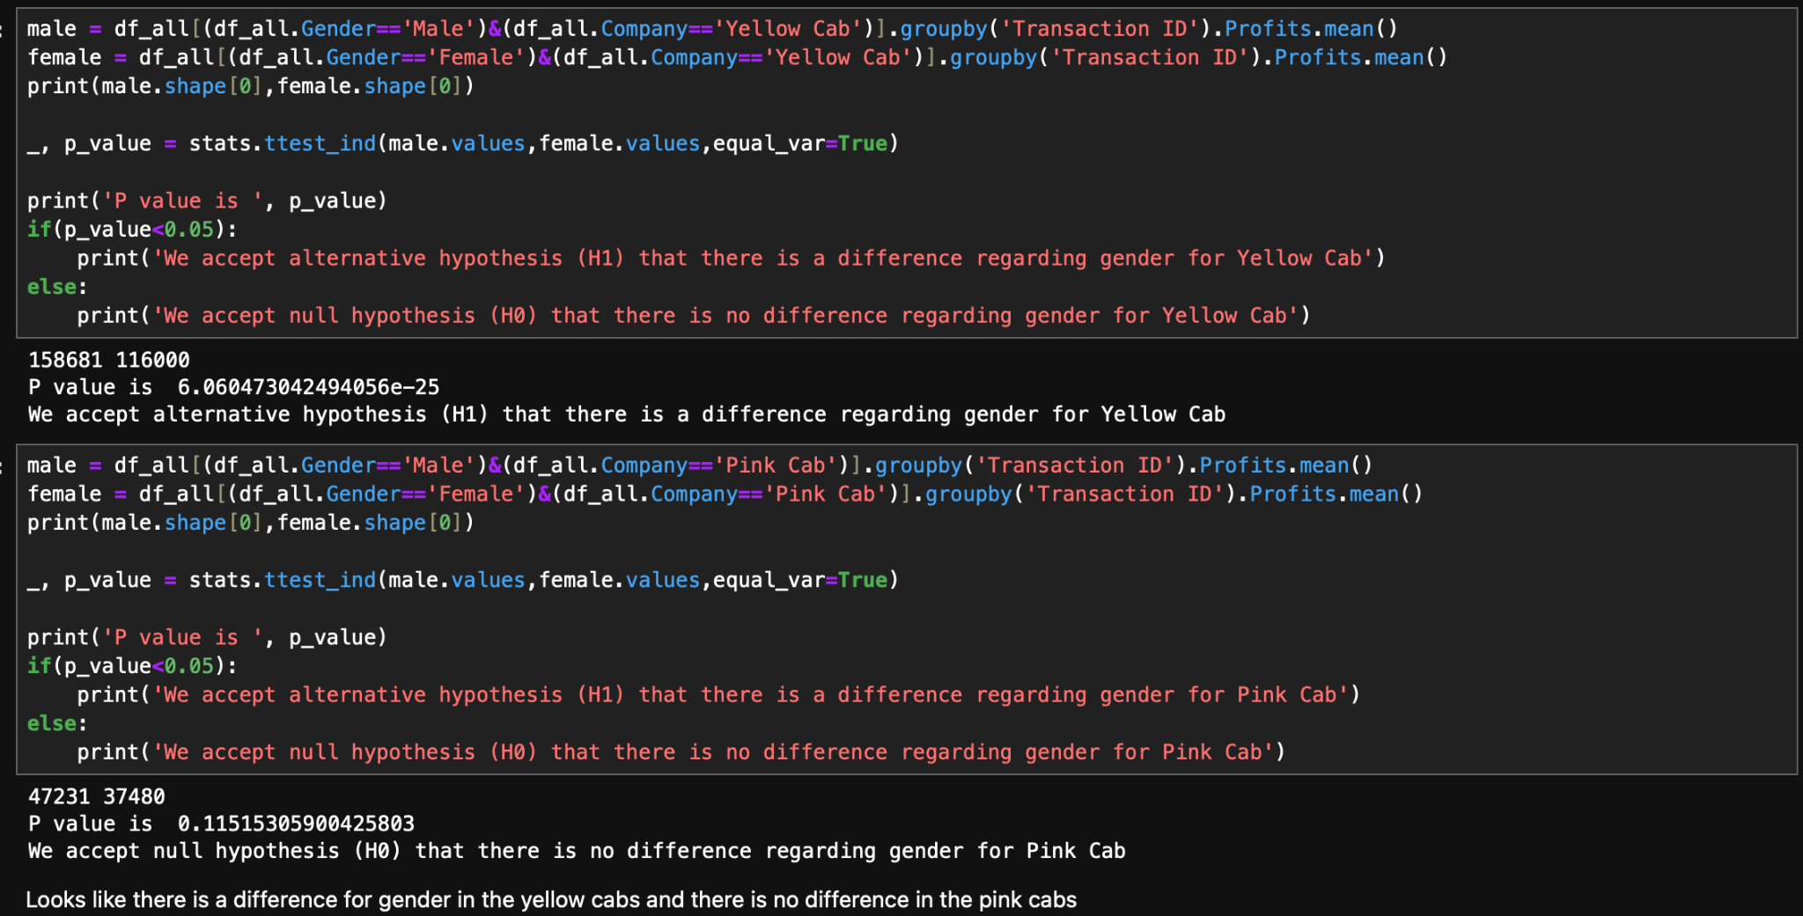
Hypothesis Testing
H₀: There is difference in the gender for the cabs
H₁: There is no such difference

Slide 18
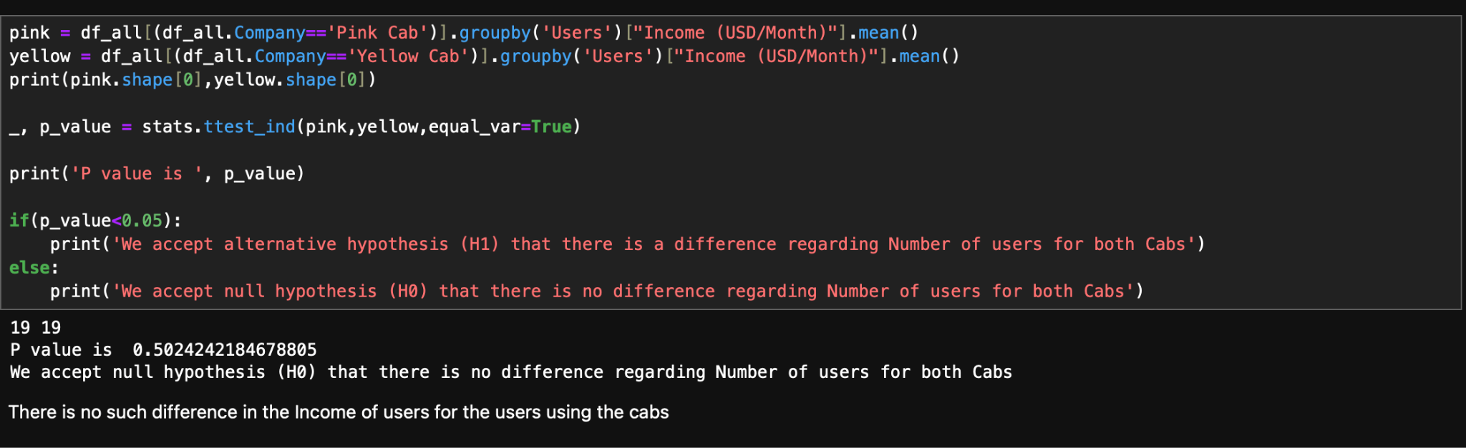
Hypothesis Testing
H₀: There is difference in the income for the users using the cabs
H₁: There is no such difference

Slide 19
Recommendations
As you can see, Yellow Cab outperforms Pink Cab in most areas. This suggests that Yellow Cab is a more successful company overall.
Here are some possible explanations for why Yellow Cab performs better than Pink Cab:
Yellow Cab may have a larger and more loyal customer base.
Yellow Cab may have a more efficient operation.
Yellow Cab may have a more competitive pricing strategy.
Yellow Cab may have a better brand reputation.

Slide 20
Thank You

